Slide 1
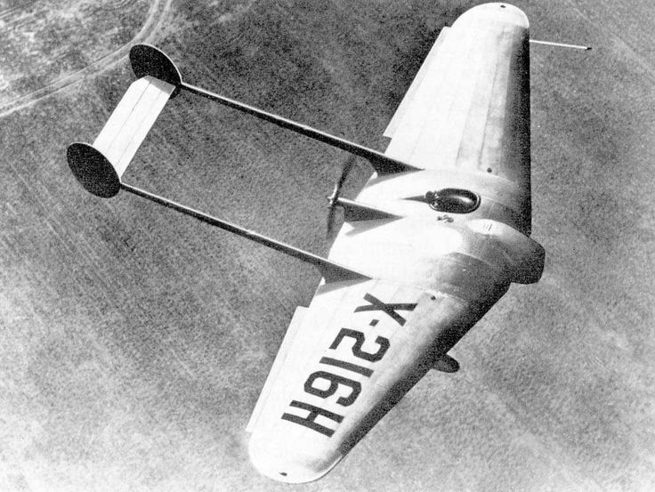

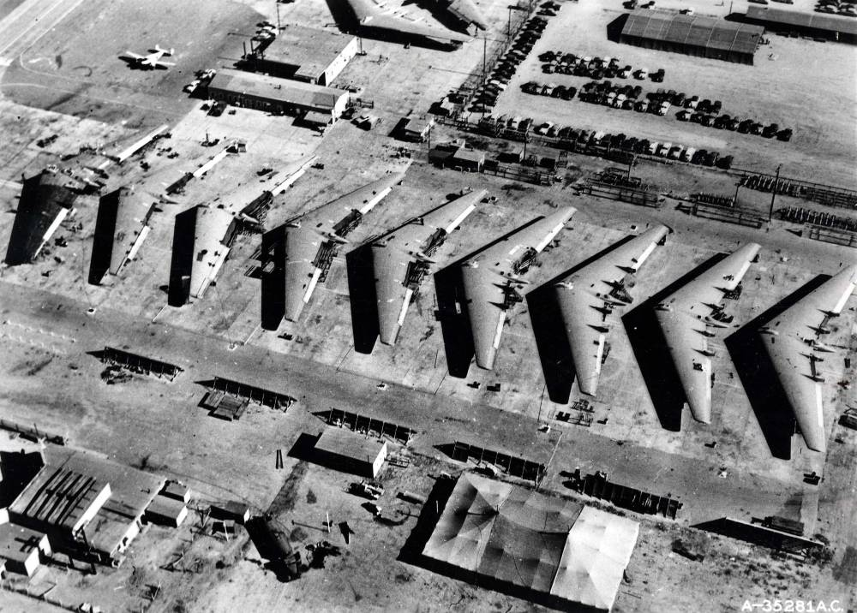
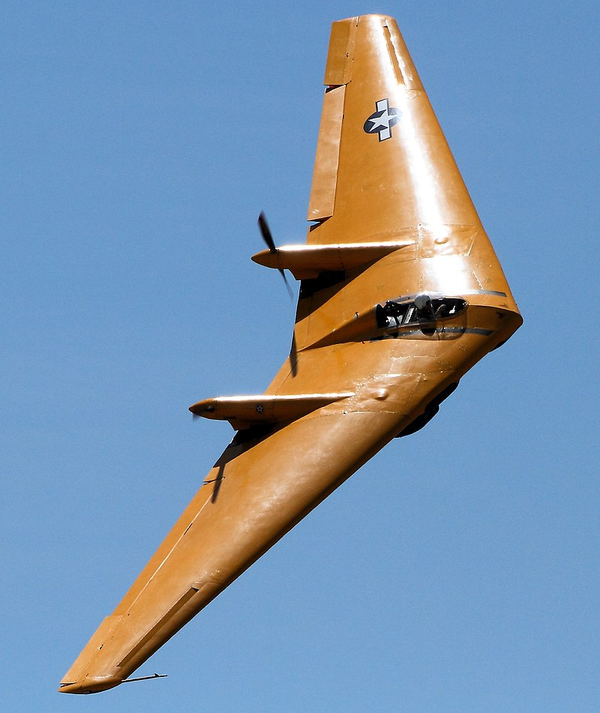
1946-1949
N-1M (1941)
N-9M (1942)
Notes:
Click to add notes
XB/YB-35 & YB49

Slide 2
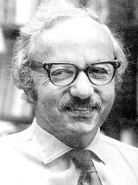
OPER 610 Lesson 05 The Simplex Method: Key Concepts
Dr Brian J. Lunday
Office: Rm 201E, Bldg 641

Slide 3
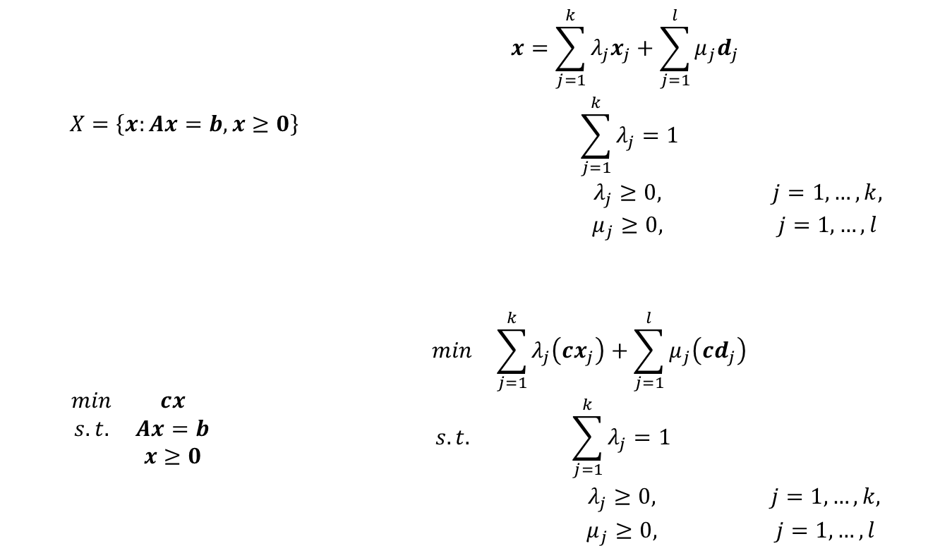
Representation of a Linear Program via EPs & EDs
$$\begin{matrix}X=\left\{x:Ax=b,x≥0\right\} & & \begin{matrix}x=\sum_{j=1}^{k}{λ_{j}x_{j}}+\sum_{j=1}^{l}{μ_{j}d_{j}} & \\ \sum_{j=1}^{k}{λ_{j}}=1 & \\ λ_{j}≥0, & j=1,…,k, \\ μ_{j}≥0, & j=1,…,l\end{matrix}\end{matrix}$$
$$\begin{matrix}\begin{matrix}min & cx \\ s.t. & Ax=b \\ & x≥0\end{matrix} & & \begin{matrix}min & \sum_{j=1}^{k}{λ_{j}\left(cx_{j}\right)}+\sum_{j=1}^{l}{μ_{j}\left(cd_{j}\right)} & \\ s.t. & \sum_{j=1}^{k}{λ_{j}}=1 & \\ & λ_{j}≥0, & j=1,…,k, \\ & μ_{j}≥0, & j=1,…,l\end{matrix}\end{matrix}$$

Slide 4
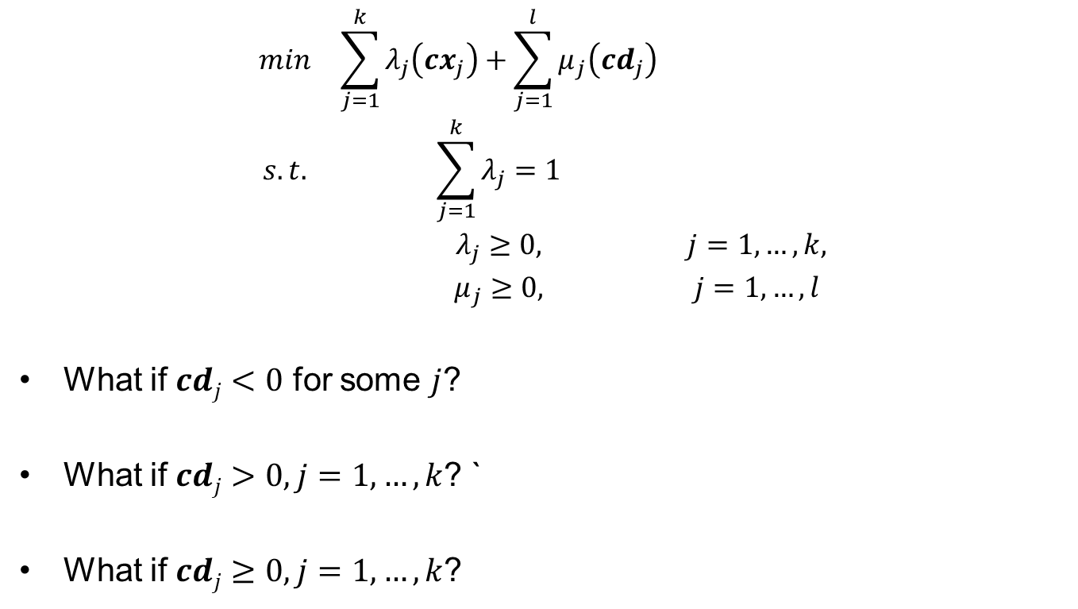
Some Questions to Ponder
$$\begin{matrix}min & \sum_{j=1}^{k}{λ_{j}\left(cx_{j}\right)}+\sum_{j=1}^{l}{μ_{j}\left(cd_{j}\right)} & \\ s.t. & \sum_{j=1}^{k}{λ_{j}}=1 & \\ & λ_{j}≥0, & j=1,…,k, \\ & μ_{j}≥0, & j=1,…,l\end{matrix}$$
What if $cdj<0$ for some $j$?
What if $cdj>0, j=1,…,k$? `
What if $cdj≥0, j=1,…,k$?

Slide 5
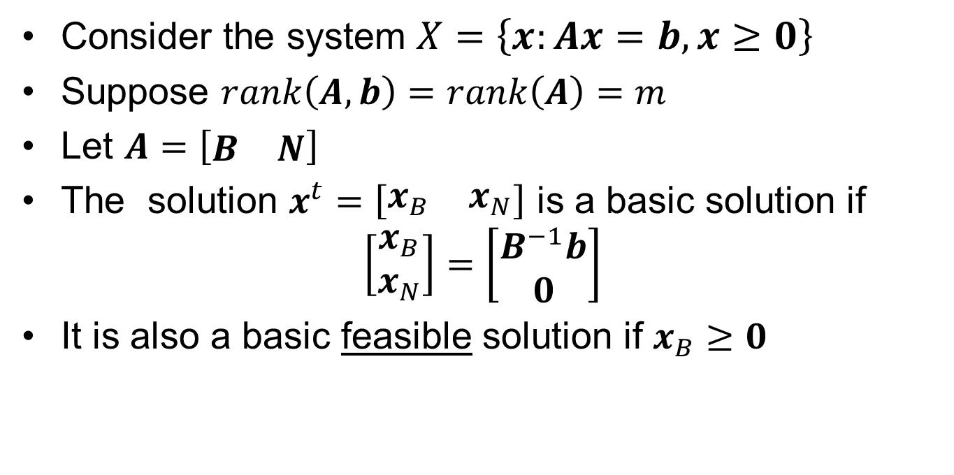
Basic Feasible Solution (BFS)
Consider the system $X=\left\{x:Ax=b,x≥0\right\}$
Suppose $rank\left(A,b\right)=rank\left(A\right)=m$
Let $A=\left[\begin{matrix}B & N\end{matrix}\right]$
The solution $x^{t}=\left[\begin{matrix}x_{B} & x_{N}\end{matrix}\right]$ is a basic solution if
$$\left[\begin{matrix}x_{B} \\ x_{N}\end{matrix}\right]=\left[\begin{matrix}B^{−1}b \\ 0\end{matrix}\right]$$
It is also a basic feasible solution if $x_{B}≥0$

Slide 6
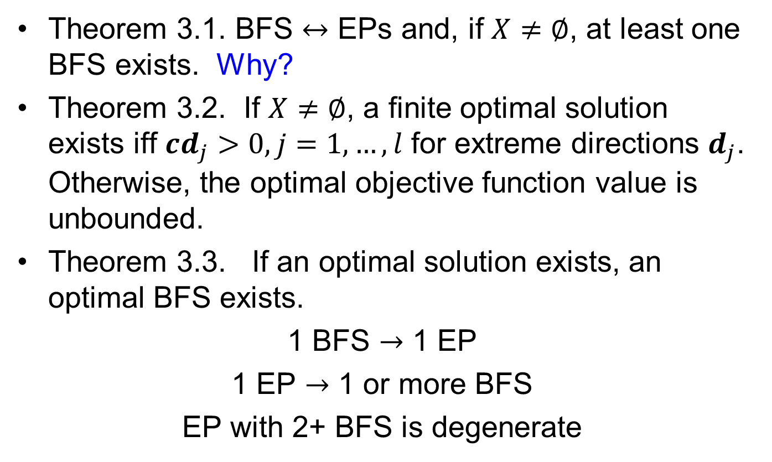
Properties of LPs
Theorem 3.1. BFS $↔$ EPs and, if $X≠∅$, at least one BFS exists. Why?
Theorem 3.2. If $X≠∅$, a finite optimal solution exists iff $cd_{j}>0, j=1,…,l$ for extreme directions $d_{j}$. Otherwise, the optimal objective function value is unbounded.
Theorem 3.3. If an optimal solution exists, an optimal BFS exists.
1 BFS $→$ 1 EP
1 EP $→$ 1 or more BFS
EP with 2+ BFS is degenerate

Slide 7


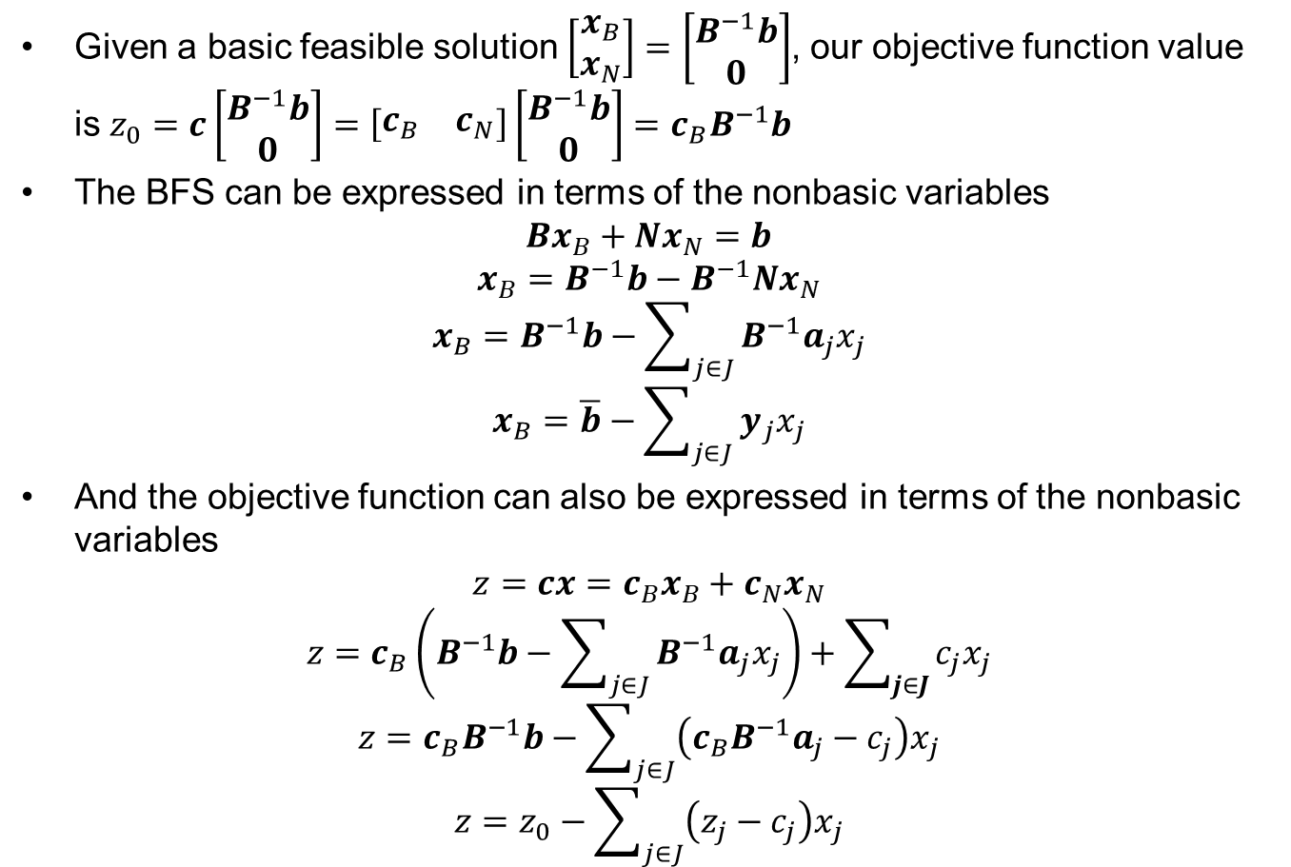


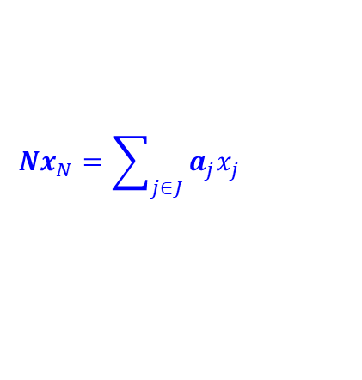
The Key to the Simplex Method! (1 of 2)
Given a basic feasible solution $\left[\begin{matrix}x_{B} \\ x_{N}\end{matrix}\right]=\left[\begin{matrix}B^{−1}b \\ 0\end{matrix}\right]$, our objective function value is $z_{0}=c\left[\begin{matrix}B^{−1}b \\ 0\end{matrix}\right]=\left[\begin{matrix}c_{B} & c_{N}\end{matrix}\right]\left[\begin{matrix}B^{−1}b \\ 0\end{matrix}\right]=c_{B}B^{−1}b$
The BFS can be expressed in terms of the nonbasic variables
$$Bx_{B}+Nx_{N}=b$$
$$x_{B}=B^{−1}b−B^{−1}Nx_{N}$$
$$x_{B}=B^{−1}b−\sum_{j∈J}{B^{−1}a_{j}x_{j}}$$
$$x_{B}=\overline{b}−\sum_{j∈J}{y_{j}x_{j}}$$
And the objective function can also be expressed in terms of the nonbasic variables
$$z=cx=c_{B}x_{B}+c_{N}x_{N}$$
$$z=c_{B}\left(B^{−1}b−\sum_{j∈J}{B^{−1}a_{j}x_{j}}\right)+\sum_{j∈J}{c_{j}x_{j}}$$
$$z=c_{B}B^{−1}b−\sum_{j∈J}{\left({c_{B}B}^{−1}a_{j}−c_{j}\right)x_{j}}$$
$$z=z_{0}−\sum_{j∈J}{\left(z_{j}−c_{j}\right)x_{j}}$$
$$Nx_{N}=\sum_{j∈J}{a_{j}x_{j}}$$
$$B^{−1}a_{j}=y_{j}$$
What happens to $xB$ as an $x_{j}↑$?
$$z_{j}={c_{B}B}^{−1}a_{j}$$
What happens to $z$ as an $x_{j}↑$?

Slide 8
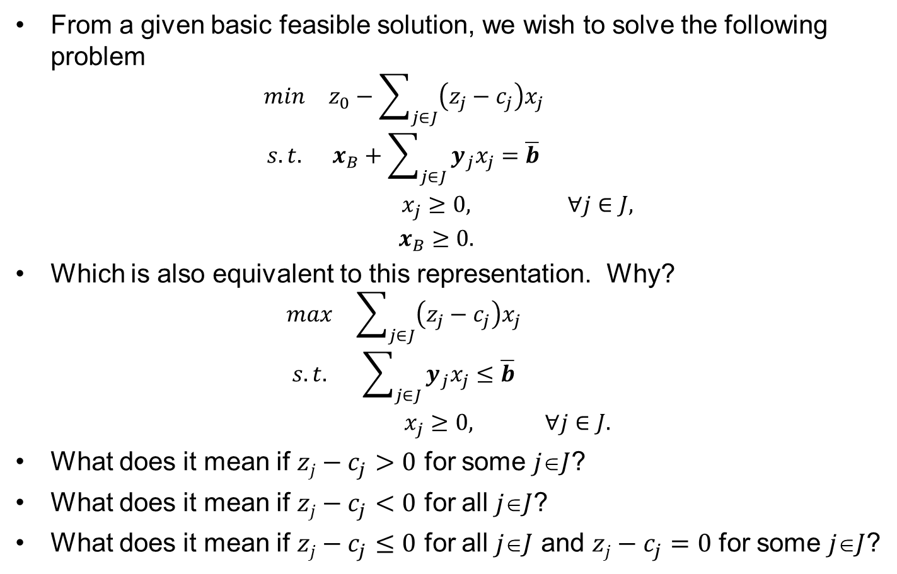
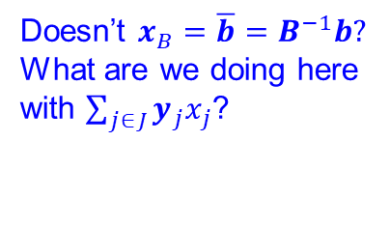
The Key to the Simplex Method! (2 of 2)
From a given basic feasible solution, we wish to solve the following problem
$$\begin{matrix}min & z_{0}−\sum_{j∈J}{\left(z_{j}−c_{j}\right)x_{j}} & \\ s.t. & x_{B}+\sum_{j∈J}{y_{j}x_{j}}=\overline{b} & \\ & x_{j}≥0, & ∀j∈J, \\ & x_{B}≥0. & \end{matrix}$$
Which is also equivalent to this representation. Why?
$$\begin{matrix}max & \sum_{j∈J}{\left(z_{j}−c_{j}\right)x_{j}} & \\ s.t. & \sum_{j∈J}{y_{j}x_{j}}≤\overline{b} & \\ & x_{j}≥0, & ∀j∈J.\end{matrix}$$
What does it mean if $zj−c_{j}>0$ for some $jJ$?
What does it mean if $zj−c_{j}<0$ for all $jJ$?
What does it mean if $zj−c_{j}≤0$ for all $jJ$ and $zj−c_{j}=0$ for some $jJ$?
Doesn’t $x_{B}=\overline{b}=B^{−1}b?$ What are we doing here with $\sum_{j∈J}{y_{j}x_{j}}$?

Slide 9
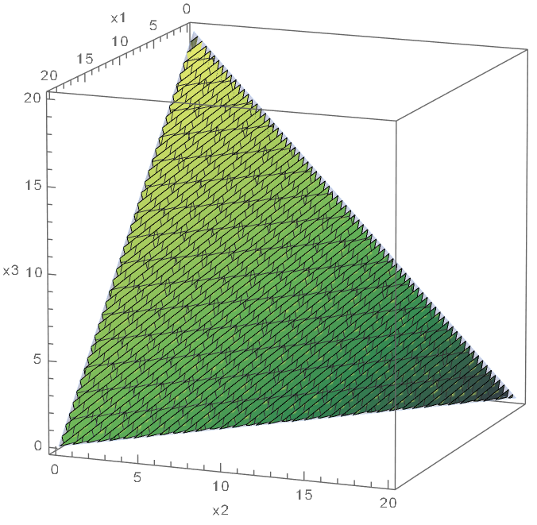
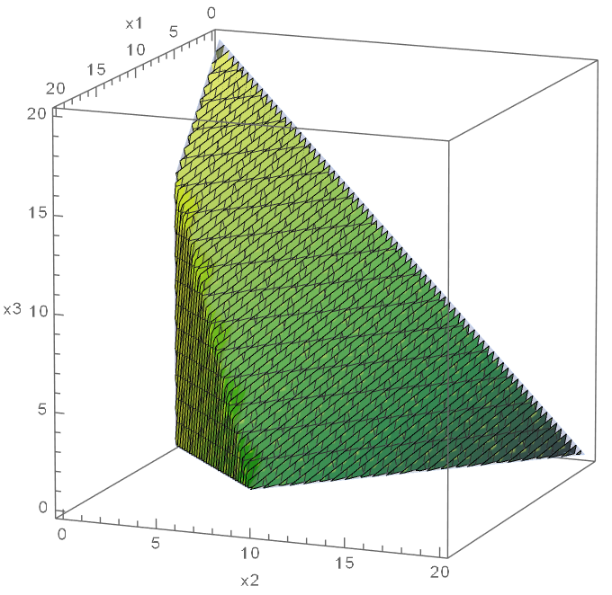
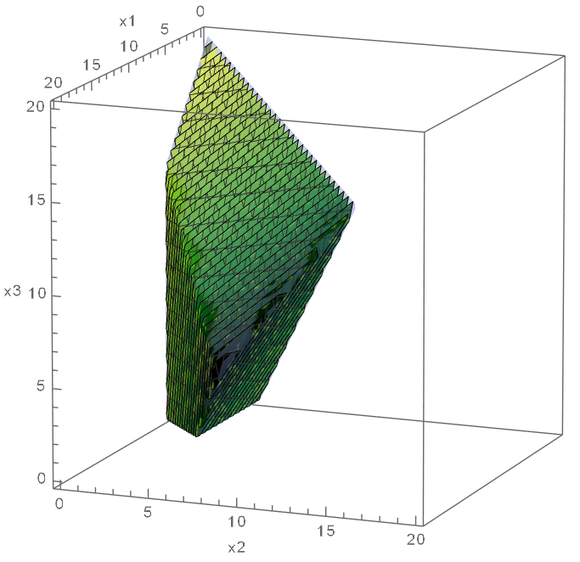
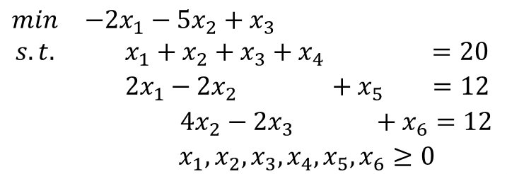
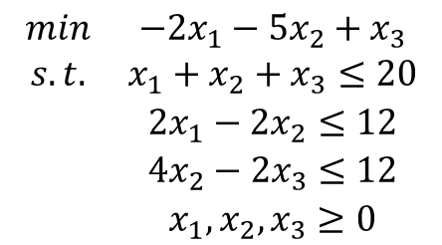
Geometry of the Simplex Method (1 of 2)
$$\begin{matrix}min & −2x_{1}−5x_{2}+x_{3} \\ s.t. & x_{1}+x_{2}+x_{3}≤20 \\ & 2x_{1}−2x_{2}≤12 \\ & 4x_{2}−2x_{3}≤12 \\ & x_{1},x_{2},x_{3}≥0\end{matrix}$$
$$\begin{matrix}min & −2x_{1}−5x_{2}+x_{3} \\ s.t. & x_{1}+x_{2}+x_{3}+x_{4} =20 \\ & 2x_{1}−2x_{2} +x_{5} =12 \\ & 4x_{2}−2x_{3} +x_{6}=12 \\ & x_{1},x_{2},x_{3},x_{4},x_{5},x_{6}≥0\end{matrix}$$
1
2
3
1
2
3

Slide 10







Geometry of the Simplex Method (2 of 2)
$$\begin{matrix}min & −2x_{1}−5x_{2}+x_{3} \\ s.t. & x_{1}+x_{2}+x_{3}+x_{4} =20 \\ & 2x_{1}−2x_{2} +x_{5} =12 \\ & 4x_{2}−2x_{3} +x_{6}=12 \\ & x_{1},x_{2},x_{3},x_{4},x_{5},x_{6}≥0\end{matrix}$$
$$x1=0$$
$$x2=0$$
Key concepts to visualize
Optimal Solution
Extreme Points & Edges
Degenerate Extreme Point
BFS
Adjacent EPs/Entering NBVs
The Simplex. What/where is it?
Blocking hyperplane
Nondegenerate iteration/pivot
Simplex path
$$x4=0$$
$$x5=0$$
$$x6=0$$
$$x3=0$$

Slide 11

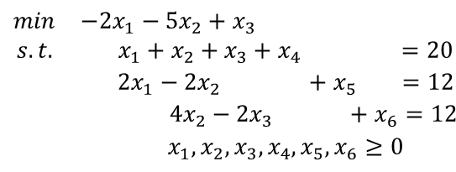

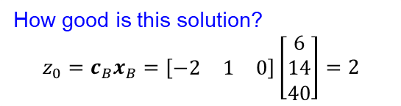
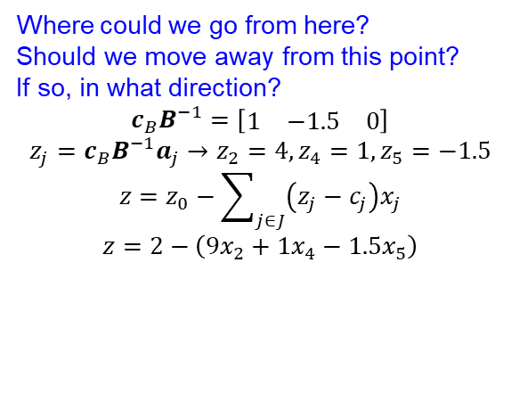
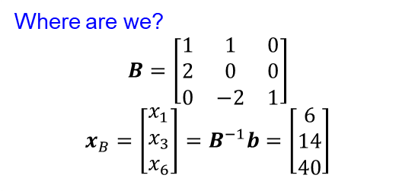
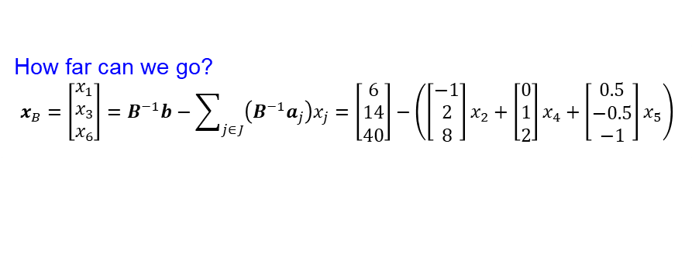

Algebra of the Simplex Method
$$\begin{matrix}min & −2x_{1}−5x_{2}+x_{3} \\ s.t. & x_{1}+x_{2}+x_{3}+x_{4} =20 \\ & 2x_{1}−2x_{2} +x_{5} =12 \\ & 4x_{2}−2x_{3} +x_{6}=12 \\ & x_{1},x_{2},x_{3},x_{4},x_{5},x_{6}≥0\end{matrix}$$
$$x_{5}↑$$
Where are we?
$$B=\left[\begin{matrix}1 & 1 & 0 \\ 2 & 0 & 0 \\ 0 & −2 & 1\end{matrix}\right]$$
$$x_{B}=\left[\begin{matrix}x_{1} \\ x_{3} \\ x_{6}\end{matrix}\right]=B^{−1}b=\left[\begin{matrix}6 \\ 14 \\ 40\end{matrix}\right]$$
$$x_{4}↑$$
$$x_{2}↑$$
How good is this solution?
$$z_{0}=c_{B}x_{B}=\left[\begin{matrix}−2 & 1 & 0\end{matrix}\right]\left[\begin{matrix}6 \\ 14 \\ 40\end{matrix}\right]=2$$
Where could we go from here?
Should we move away from this point?
If so, in what direction?
$$c_{B}B^{−1}=\left[\begin{matrix}1 & −1.5 & 0\end{matrix}\right]$$
$$z_{j}=c_{B}B^{−1}a_{j}→z_{2}=4,z_{4}=1,z_{5}=−1.5$$
$$z=z_{0}−\sum_{j∈J}{\left(z_{j}−c_{j}\right)x_{j}}$$
$$z=2−\left(9x_{2}+1x_{4}−1.5x_{5}\right)$$
How far can we go?
$$x_{B}=\left[\begin{matrix}x_{1} \\ x_{3} \\ x_{6}\end{matrix}\right]=B^{−1}b−\sum_{j∈J}{\left(B^{−1}a_{j}\right)x_{j}}=\left[\begin{matrix}6 \\ 14 \\ 40\end{matrix}\right]−\left(\left[\begin{matrix}−1 \\ 2 \\ 8\end{matrix}\right]x_{2}+\left[\begin{matrix}0 \\ 1 \\ 2\end{matrix}\right]x_{4}+\left[\begin{matrix}0.5 \\ −0.5 \\ −1\end{matrix}\right]x_{5}\right)$$

Slide 12
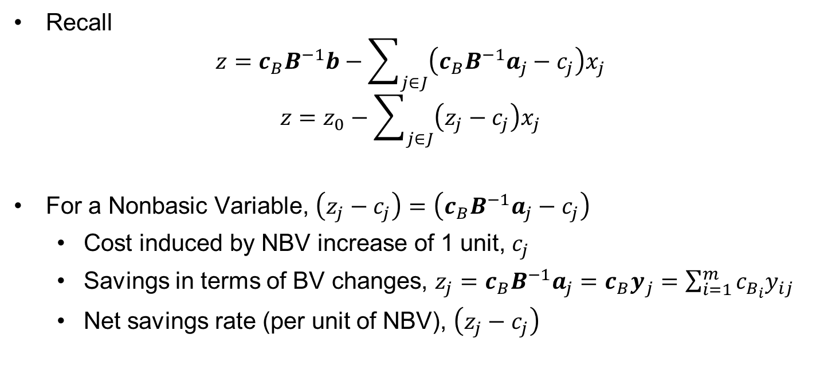

What is $\left(z_{j}−c_{j}\right)$?
Recall
$$z=c_{B}B^{−1}b−\sum_{j∈J}{\left(c_{B}B^{−1}a_{j}−c_{j}\right)x_{j}}$$
$$z=z_{0}−\sum_{j∈J}{\left(z_{j}−c_{j}\right)x_{j}}$$
For a Nonbasic Variable, $\left(z_{j}−c_{j}\right)=\left(c_{B}B^{−1}a_{j}−c_{j}\right)$
Cost induced by NBV increase of 1 unit, $c_{j}$
Savings in terms of BV changes, $z_{j}=c_{B}B^{−1}a_{j}=c_{B}y_{j}=\sum_{i=1}^{m}{c_{B_{i}}y_{ij}}$
Net savings rate (per unit of NBV), $\left(z_{j}−c_{j}\right)$

Slide 13
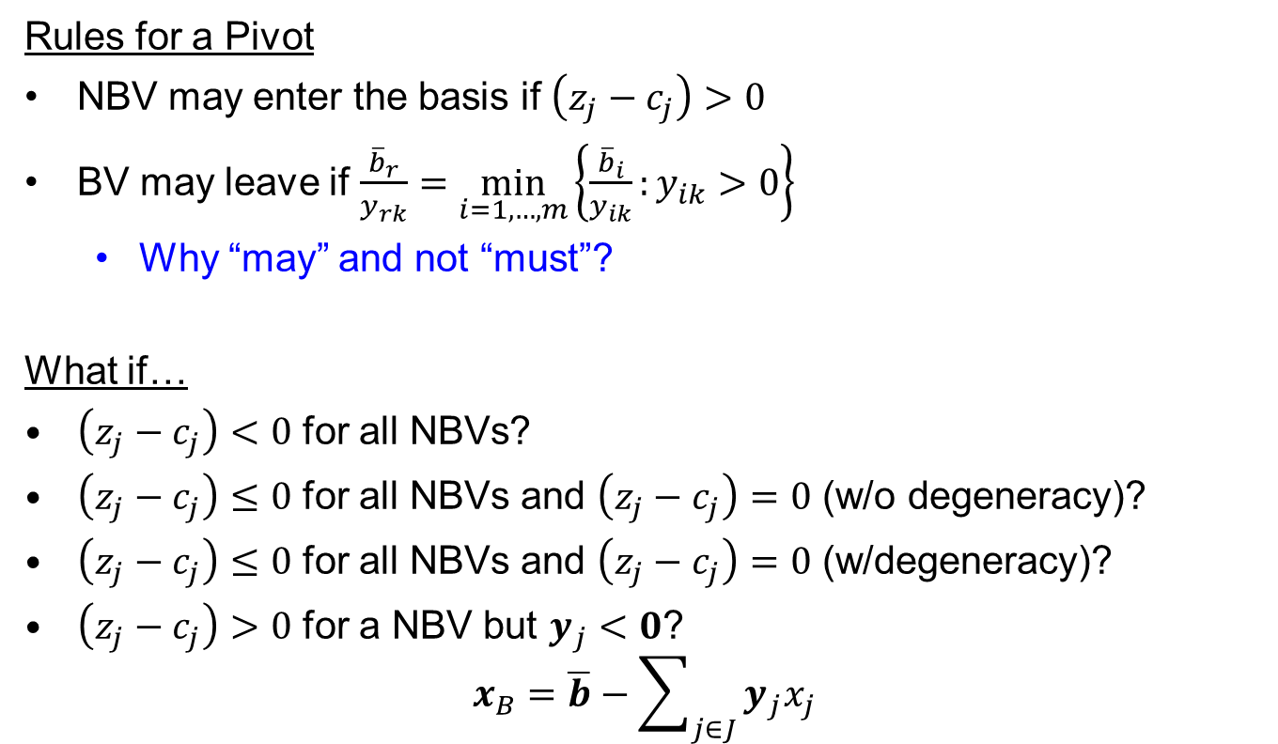

Conditioning on $\left(z_{j}−c_{j}\right)$’s
Rules for a Pivot
NBV may enter the basis if $\left(z_{j}−c_{j}\right)>0$
BV may leave if $\frac{{\overline{b}}_{r}}{y_{rk}}=\min_{i=1,…,m}\left\{\frac{{\overline{b}}_{i}}{y_{ik}}:y_{ik}>0\right\}$
Why “may” and not “must”?
What if…
$\left(z_{j}−c_{j}\right)<0$ for all NBVs?
$\left(z_{j}−c_{j}\right)≤0$ for all NBVs and $\left(z_{j}−c_{j}\right)=0$ (w/o degeneracy)?
$\left(z_{j}−c_{j}\right)≤0$ for all NBVs and $\left(z_{j}−c_{j}\right)=0$ (w/degeneracy)?
$\left(z_{j}−c_{j}\right)>0$ for a NBV but $y_{j}<0$?
$$x_{B}=\overline{b}−\sum_{j∈J}{y_{j}x_{j}}$$

Slide 14
Questions & Discussion

Slide 15
For Next Class
Sections 3.7 & 3.8
Compare the algebraic and tableau implementations of the Simplex Method
Supplemental reading on Canvas
Dantzig, G. B. (1988). Impact of Linear Programming on Computer Development. OR/MS Today, 8 (Aug), 12-17.
Homework #4
Problems 2.24, 2.40, 3.1

